Slide 1

DATA VISUALIZATION
Softwarica College of IT and E-Commerce 5014CEM Data Science for Developers 2022
Interactive Data Visualization – Foundation, Techniques, and Applications
Matthew Ward │ Georges Grinstein │ Daniel Keim

Slide 2

Interactive Data Visualization
Introduction
Interactive Data Visualization – Foundation, Techniques, and Applications Matthew Ward │ Georges Grinstein │ Daniel Keim
2

Slide 3

Introduction
What is Visualization?
History of Visualization
Relationship between Visualization and Other Fields
The Visualization Process
Pseudocode Conventions
The Scatterplot
The Role of the User
Miscellaneous (Related Readings/ Exercises/ Projects)

Slide 4
Introduction
Reasons for using visualizations
Visualization application to problem solving
Process of visualization
Visualization pipeline and other data analysis pipelines

Slide 5


1. WHAT IS VISUALIZATION?
Visualization in Everyday Life
Why Is Visualization Important?

Slide 6
1. What Is Visualization?
Definition:
Visualization – communication of information using graphical representations
Picture vs text
Image interpretation – parallel process
Text analysis – sequential process of reading
Pictures are independent of language

Slide 7
1.1. Visualization in Everyday Life
The result of a financial and stock market analysis
A mechanical and civil engineering rotary bridge design and systems analysis
A breast cancer MRI for diagnosis and therapy
A comet path data and trend analysis
The analysis of human population smoking behaviors
A study of actuarial data for confirming and guiding quantitative analysis
The simulation of complex process
The analysis of a simulation of a physical system
A visual representation of Facebook friends and their connections
Marketing posters and advertising

Slide 8
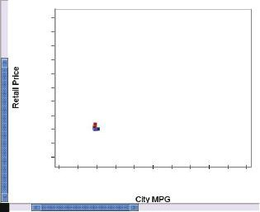
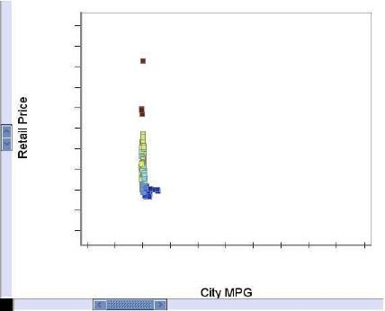
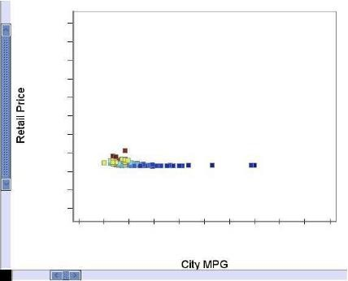
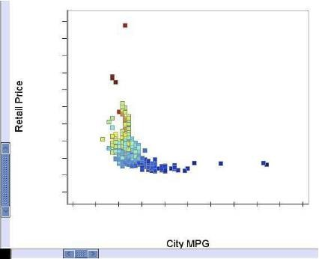
1.2. Why Is Visualization Important?
The same data plotted with different scales is perceived dramatically differently:
(a) Equally (uniformly) large scale in both x and y
(b) Large scale in y
(c) Large scale in y
(d) Scale determined by range of
x- and y-values.

Slide 9
1.2. Why Is Visualization Important?
Sight – one of our key senses for information understanding
Example 1: effect of the presentation of data on the decision-making process
Fig.1.1(a) large uniform scale – values are close to each others, no differentiation of individual data points
Fig.1.1(b) larger scale of y-axis – linear horizontal pattern (clustering in the vertical direction)
Fig.1.1(c) larger scale of x-axis – linear vertical pattern (clustering in the horizontal direction)
Fig.1.1(d) use the range of data to determine the scaling

Slide 10
1.2. Why Is Visualization Important?
Decision:
The plot is very linear – (a-c)
Inversely proportional – (d)
Scaling can distort the “truthful” representation of data

Slide 11
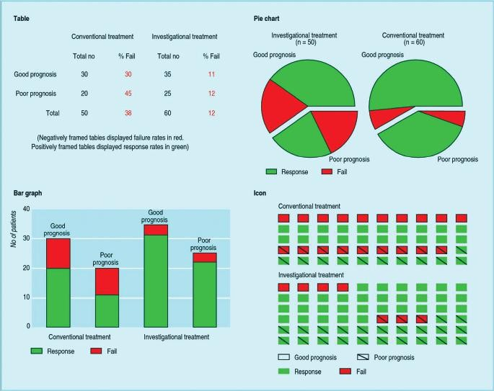
1.2. Why Is Visualization Important?
The icon display (lower right)
– the most effective for the decision to stop the clinical trial:
(a) Table
(b) Bar Graph
(c) Pie Chart
(d) Icon

Slide 12
1.2. Why Is Visualization Important?
Example 2: effect of the presentation of data on the decision-making process.
Conventional and the investigational treatments of patients are presented. The green color shows that the drug induced a response and the red that none occurred.
The Decision to stop based on difference between two treatments
Fig.1.2(a) table
Fig.1.2(b) bar graph
Fig.1.2(c) pie chart
Fig.1.2(d) sequence of rectangles, each representing a patient

Slide 13
1.2. Why Is Visualization Important?
Decision:
Correct decisions were 82% with icon display, 68% with tables, and 56% with pie charts
Most (21 out of 34) clinicians preferred the table
Not only visualization that is key in presenting data well, but user preferences are heavily involved

Slide 14
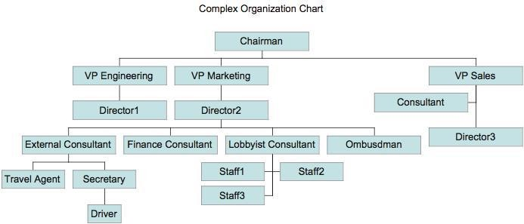
1.2. Why Is Visualization Important?
Example 3: Visualization vs. text

Slide 15
1.2. Why Is Visualization Important?
An organizational chart that is difficult to describe verbally but can easily be comprehended with only brief examination
Interpretation:
Marketing has the most consultants
Driver has the longest chain of command

Slide 16
2. HISTORY OF VISUALIZATION
Early Visualizations
Visualization Today

Slide 17
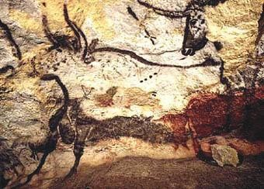
2.1. Early Visualizations
One of the Lascaux cave painting

Slide 18

2.1. Early Visualizations
Early graphical writing. The Kish limestone tablet from Mesopotamia.

Slide 19
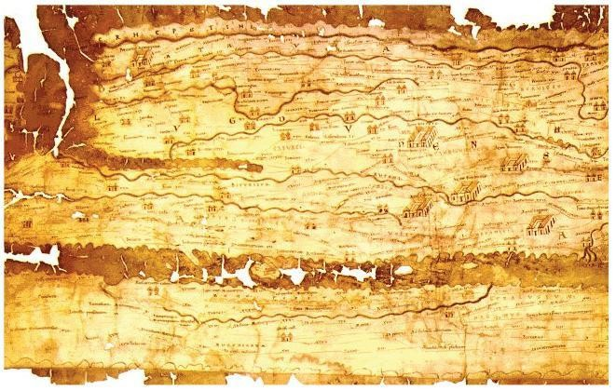
2.1. Early Visualizations
A copy of one of the 12 pages of the Peutinger Map set, showing the roads of the Roman Empire.

Slide 20
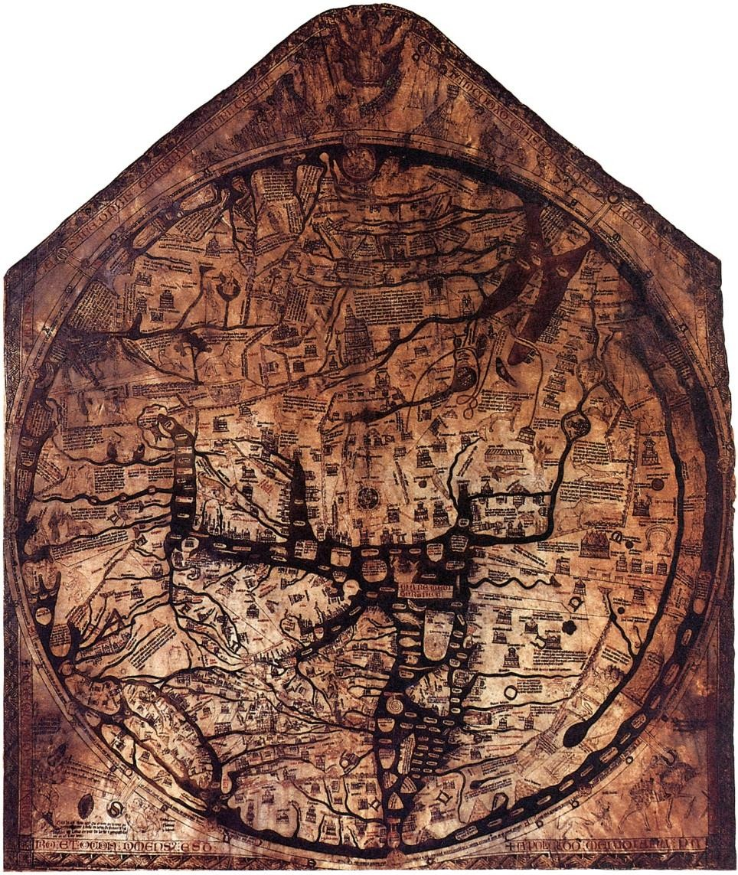
2.1. Early Visualizations
The famous Hereford map, the largest surviving map of the Middle Ages (1280s).
Wikimedia Commons

Slide 21
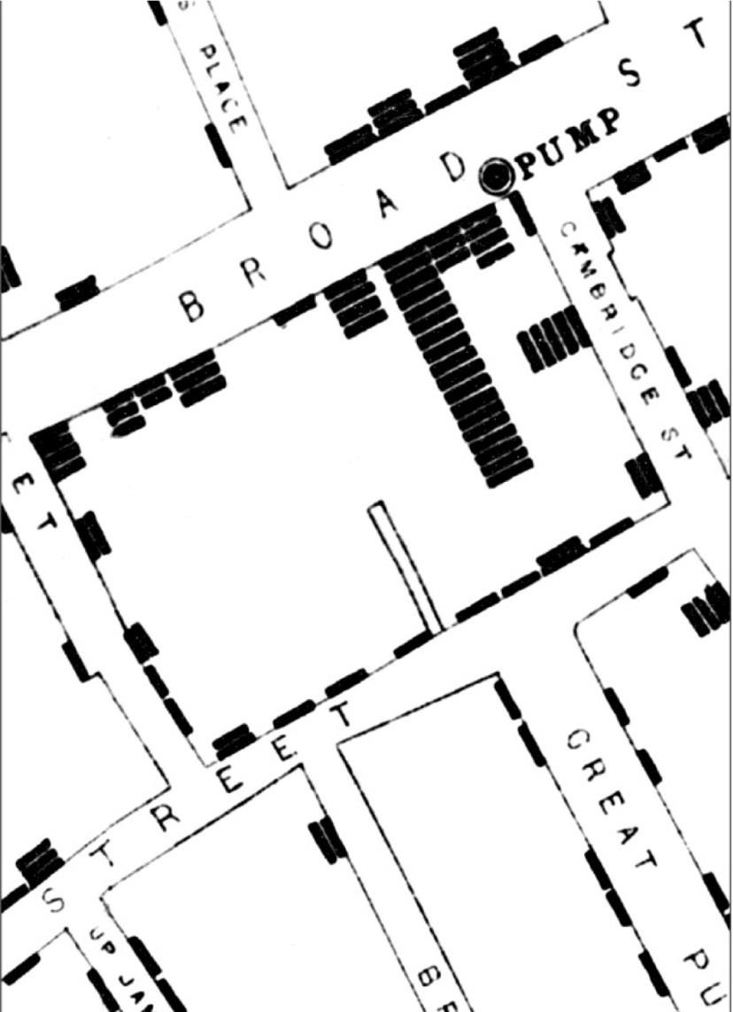
2.1. Early Visualizations
A section of John Snow’s map of the deaths from cholera in London in 1663.
Each bar within the houses represents one deceased individual.
Wikimedia Commons

Slide 22
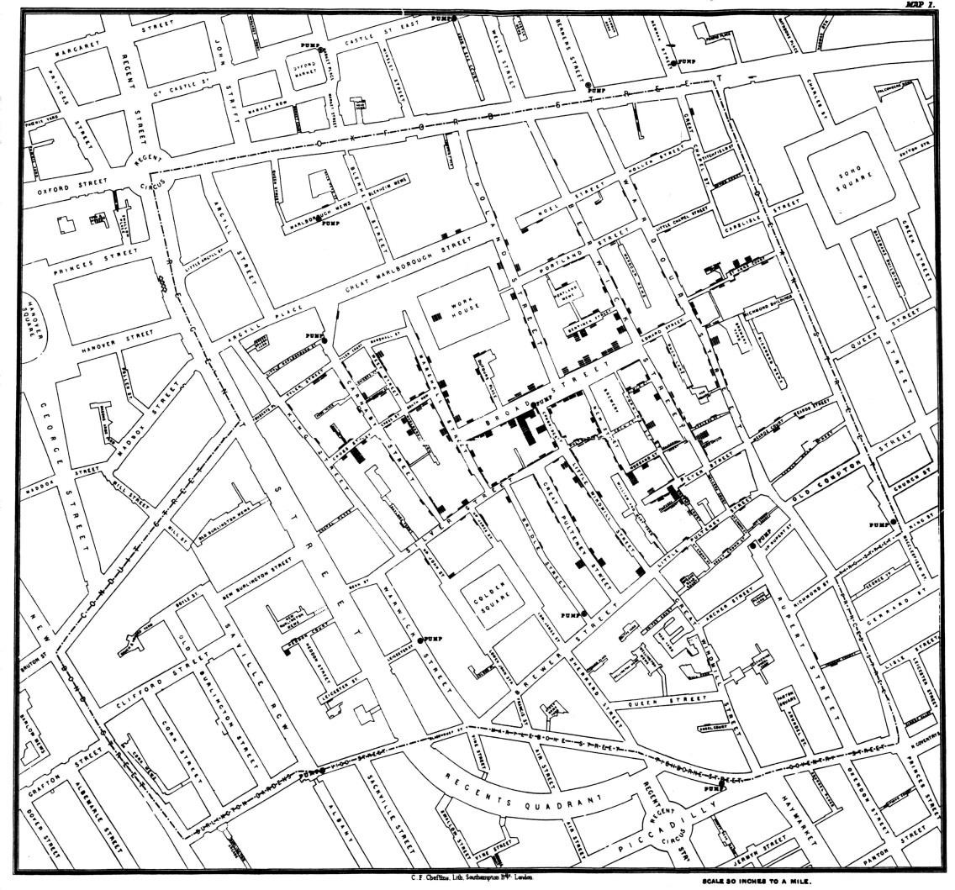
2.1. Early Visualizations
Overview map of the deaths from Cholera in London in 1663.
Note the concentration around the Broad Street Water Pump. Note as well the outliers.
Wikimedia Commons

Slide 23
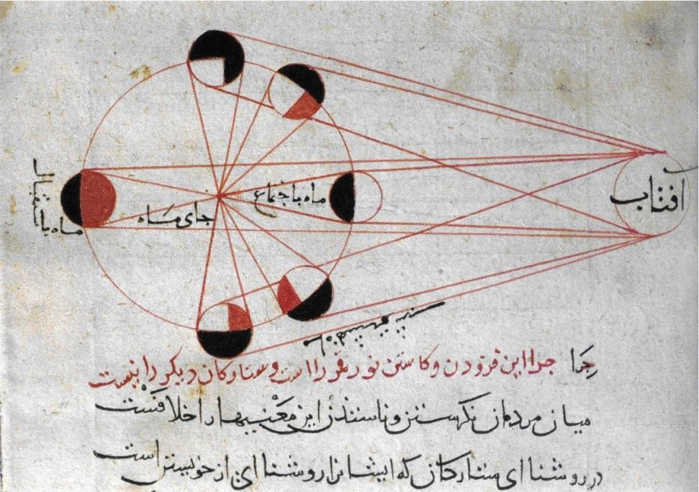
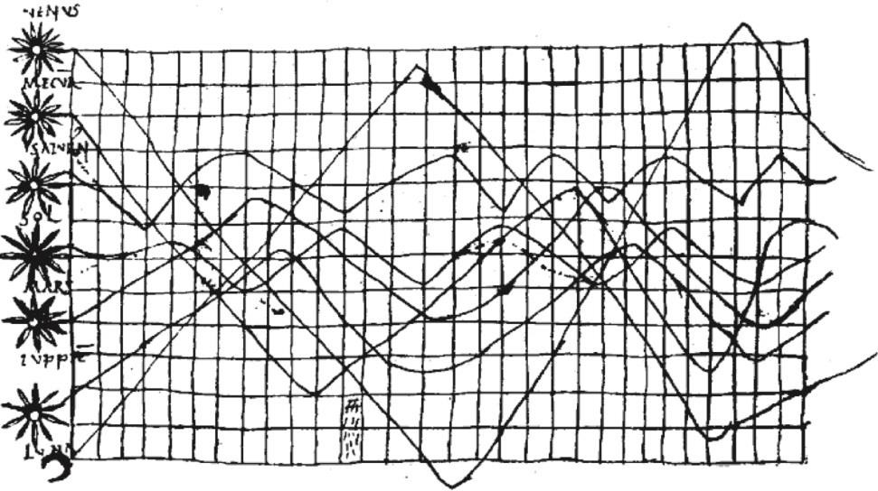
2.1. Early Visualizations
Two early time series visualizations:
Wikimedia Commons
Wikimedia Commons
Produced by Biruni circa 1030.
Shows the phases of the moon in orbit.
Shows planetary motion.

Slide 24
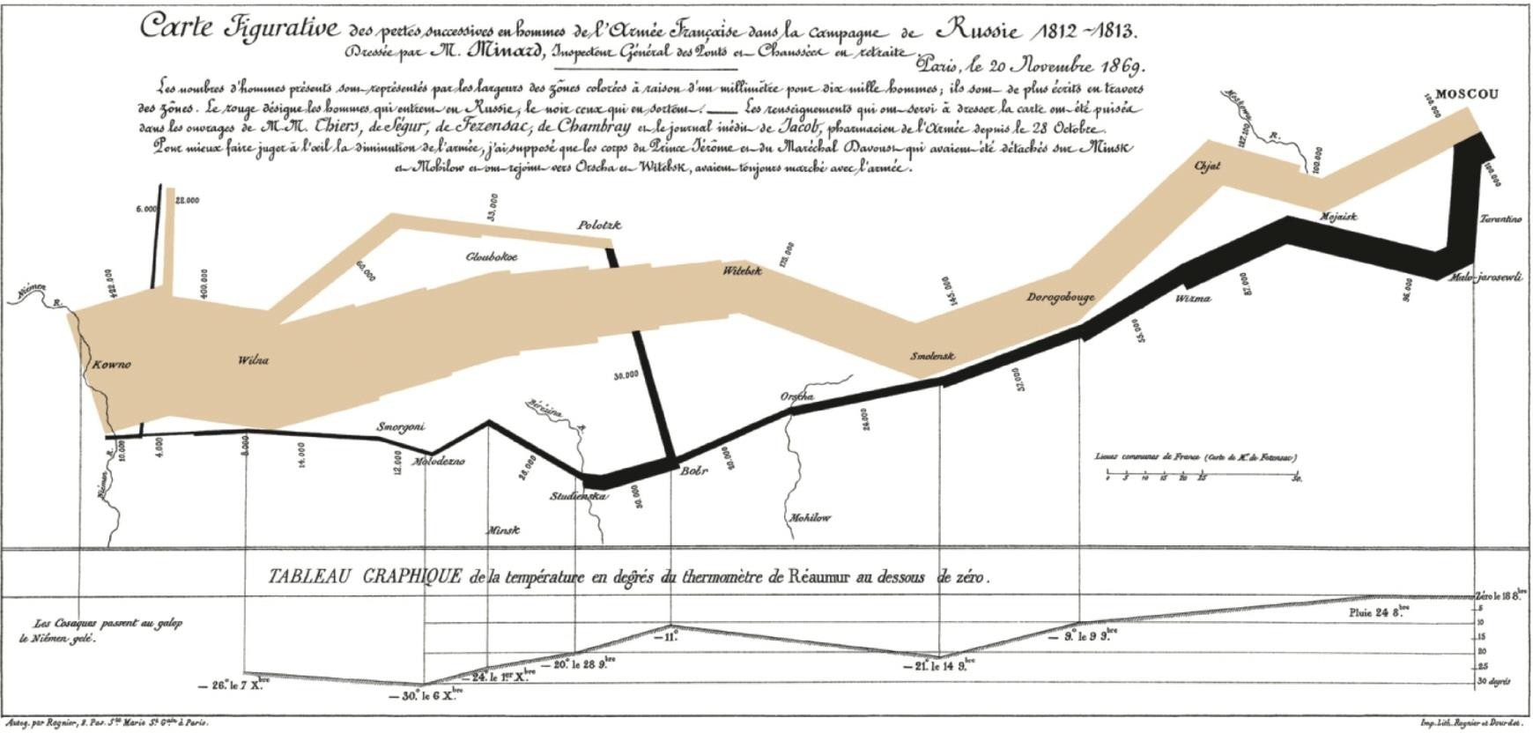
2.1. Early Visualizations
Wikimedia Commons
Minard’s map, showing Napoleon’s march on Moscow. The width of the line conveys the size of the army at that location. Color indicates the direction of movement. The temperature is plotted at different points along the retreat at the bottom.

Slide 25
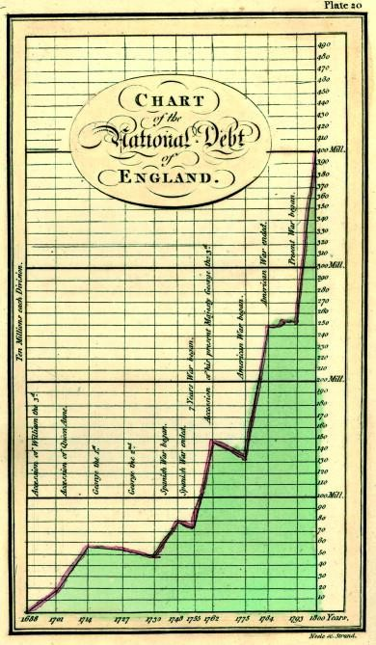
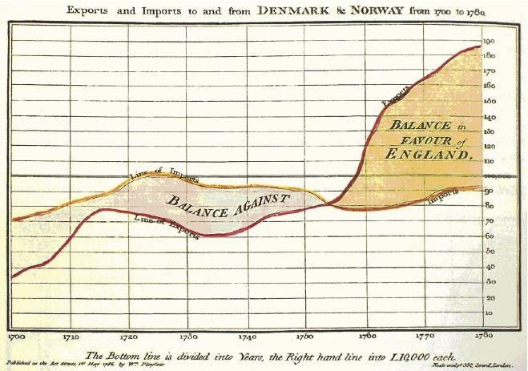
2.1. Early Visualizations
Early visualizations of William Playfair:
A plot of the national debt
over time.
A display of the balance of trade between England and Norway/
Denmark (1786).
Wikimedia Commons
Wikimedia Commons

Slide 26
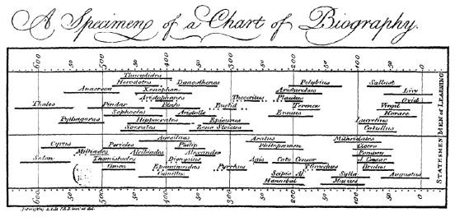
2.1. Early Visualizations
Wikimedia Commons
Joseph Priestley’s display of the longevity of famous people (1765).

Slide 27
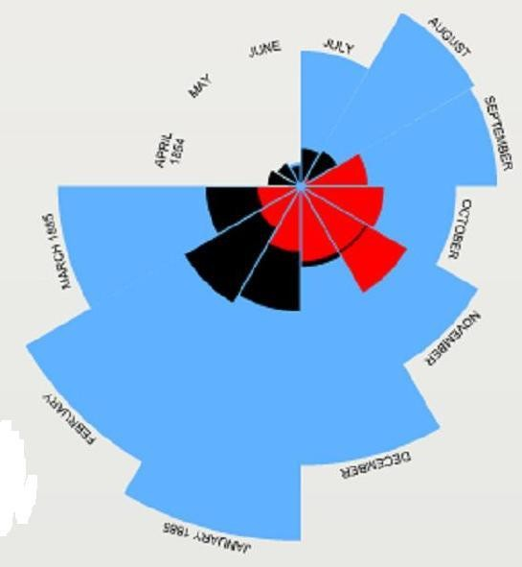
2.1. Early Visualizations
Florence Nightingale’s coxcomb chart showing monthly deaths from battle and other causes.
Blue represents the deaths from disease, red represents deaths from wounds, and black represents all other deaths.
http://understandinguncertainty.org/node/213

Slide 28
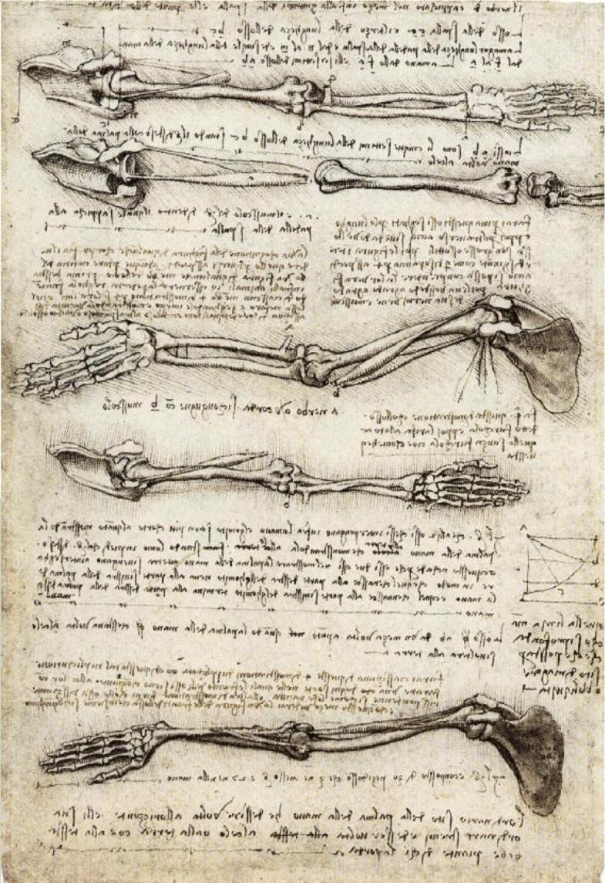
2.1. Early Visualizations
Leonardo Da Vinci’s study of the motion of the human arm (1510).
Wikimedia Commons

Slide 29
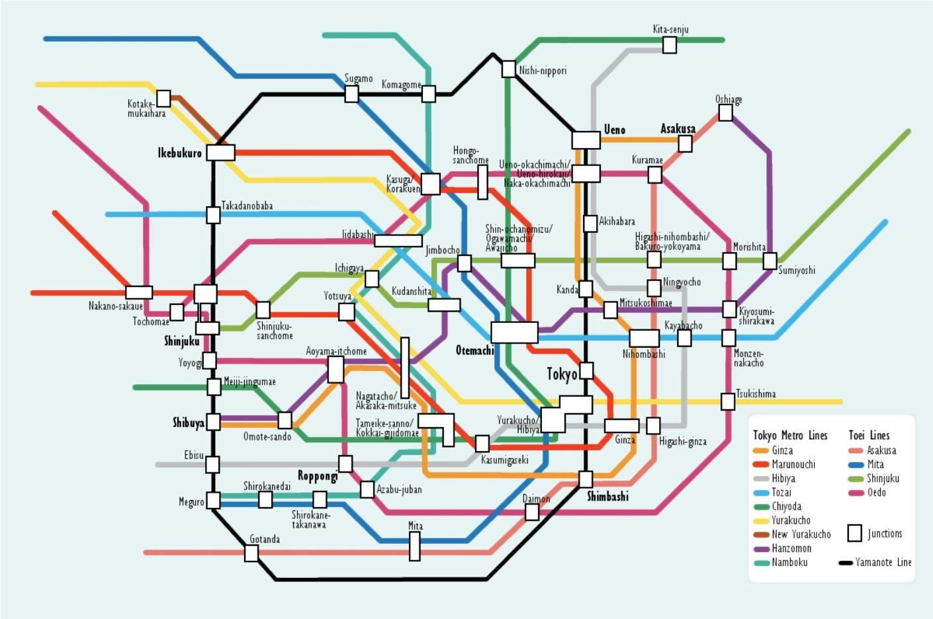
2.2. Visualization Today
The Tokyo Underground map. A logical representation of the metro highlighting qualitative relationships between the stops.
Wikimedia Commons

Slide 30
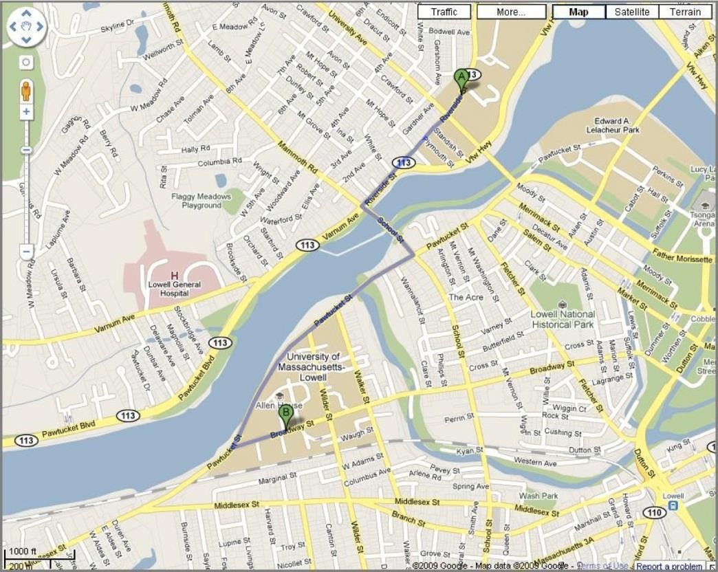
2.2. Visualization Today
2009 Google
The google.com map directions from 198 Riverside St., Lowell, MA (UMass Lowell, North Campus) to 883 Broadway St., Lowell, MA (UMass Lowell, South Campus). Google.com maps provide graphical cues drawn on top of road maps to indicate driving directions from point A to point B.

Slide 31
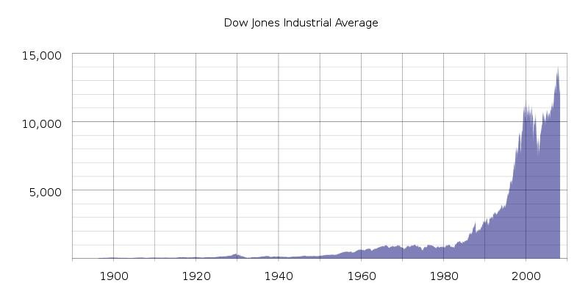
2.2. Visualization Today
Wikimedia Commons
Dow Jones Industrial Average (DJIA) from 1900 to 2000. The Dow Jones Industrial Average is a U.S. stock index based on the weighted average of the stock prices of 30 large and actively traded U.S. companies. The divisor changes over time as stock splits, so as not to alter that average in those cases.

Slide 32
2.2. Visualization Today
$23,185,045,484,527.11
The current outstanding public debt of the United States as of January 15, 2020. http://www.usdebtclock.org/ or http://www.usgovernmentdebt.us/

Slide 33
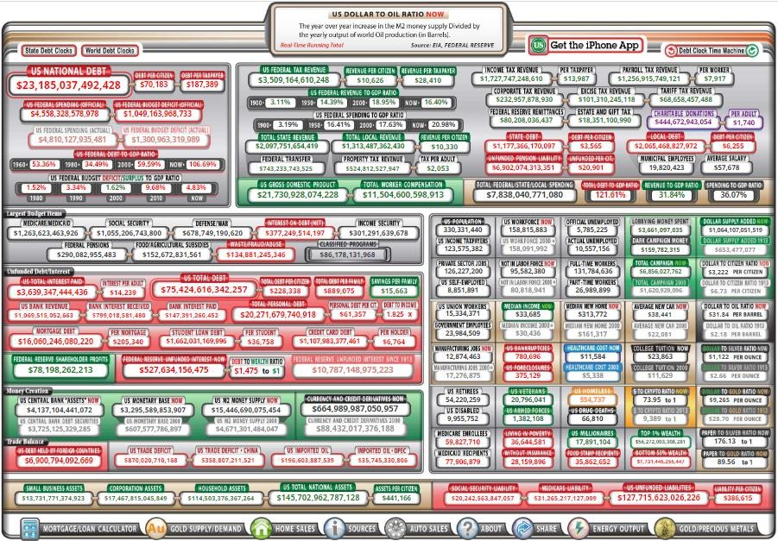
2.2. Visualization Today
The current outstanding public debt of the United States as of January 15, 2020. http://www.usdebtclock.org/

Slide 34
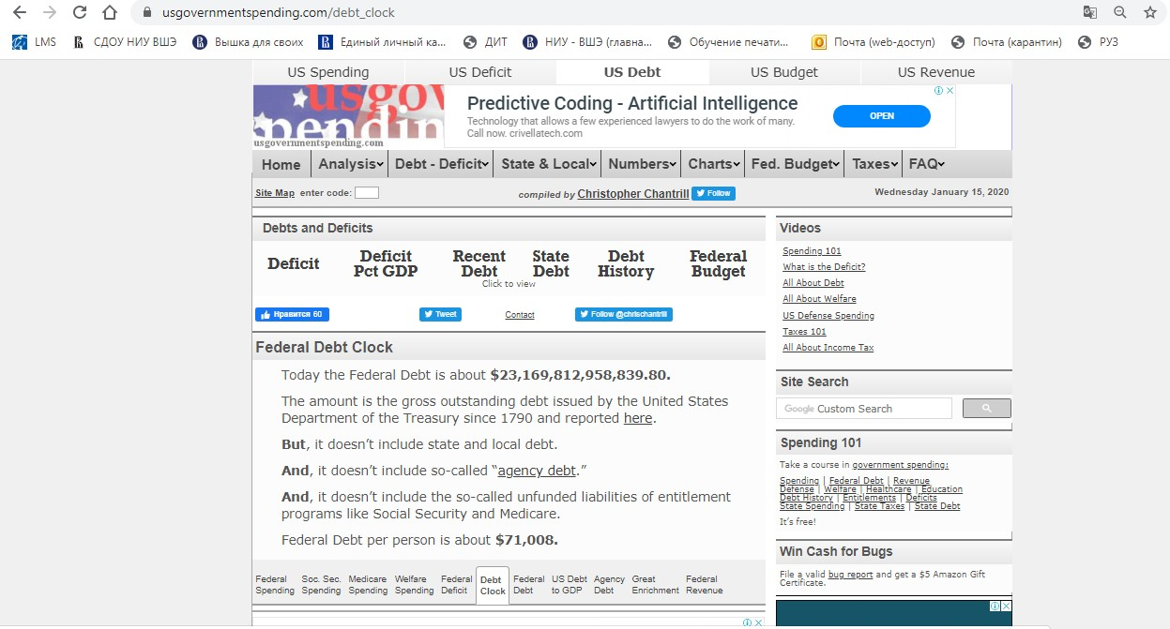
2.2. Visualization Today
The current outstanding public debt of the United States as of January 15, 2020. http://www.usgovernmentdebt.us/

Slide 35
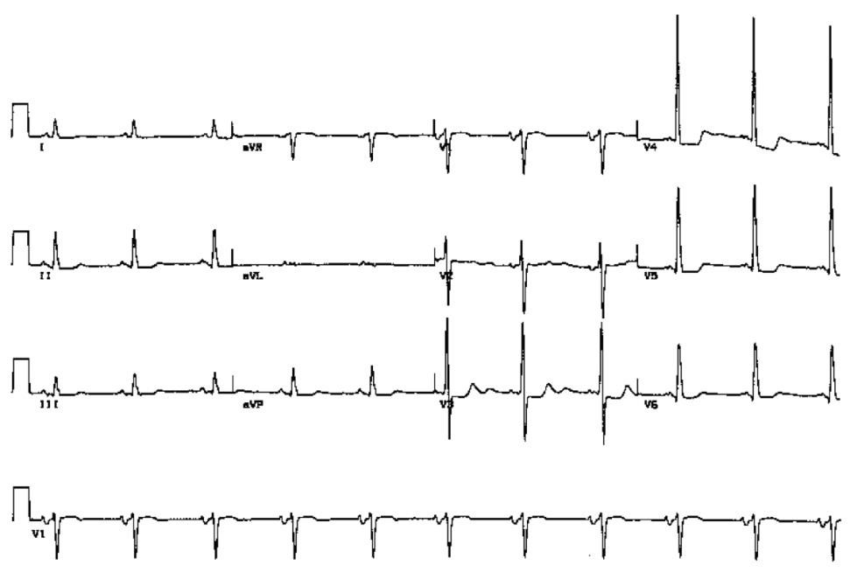
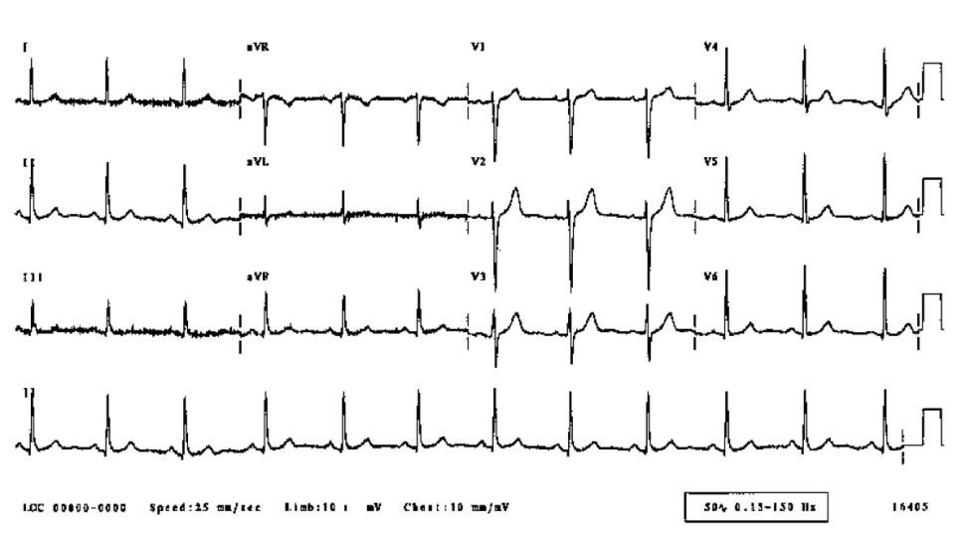
2.2. Visualization Today
Two examples of 12-lead ECGs:
A normal adult:
An 83-year-old adult with heart problems:
http://www.ecglibrary.com/ecghome.html
http://www.ecglibrary.com/ecghome.html

Slide 36
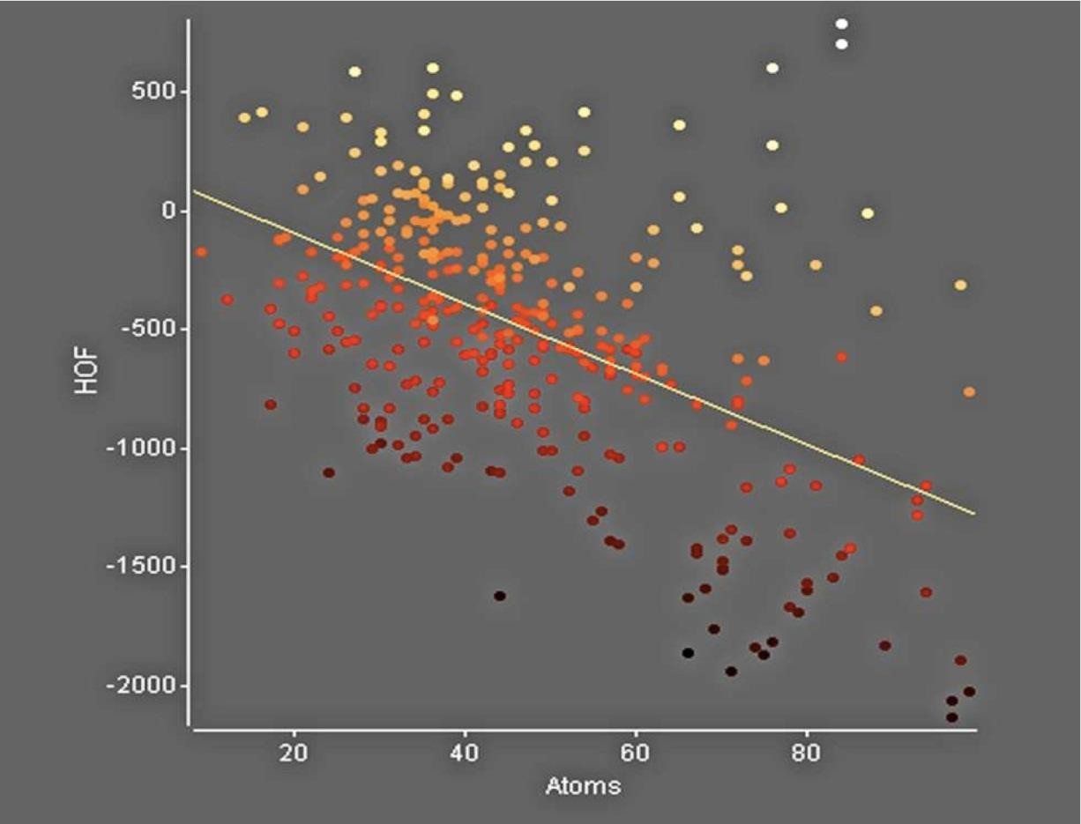
2.2. Visualization Today
Yeast mechanism of action data with regression line.
Yeast are single-celled microorganisms that are classified, along with molds and mushrooms, as members of the Kingdom Fungi.
Source: https://en.wikipedia.org/wiki/Yeast
Umass Lowell UVP Software (http://www.uvp.com/visionworks.html)

Slide 37
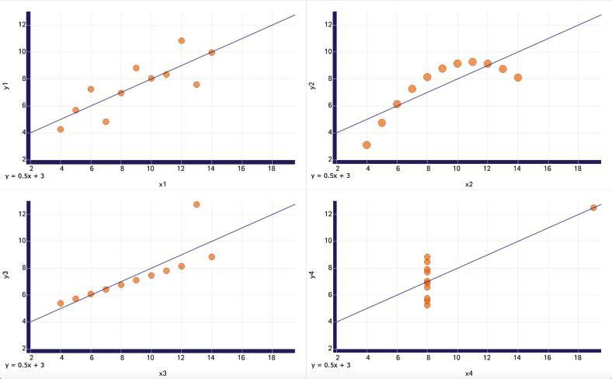
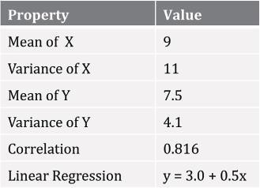
2.2. Visualization Today
Plots of four data sets with identical statistics

Slide 38
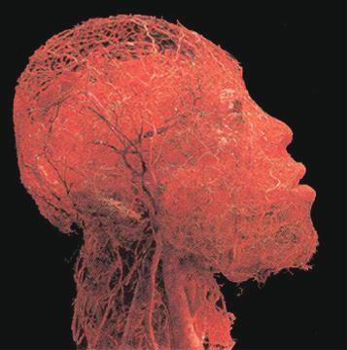
2.2. Visualization Today
Blood vessel configuration of the head and brain.
Image c Gunther von Hagens, Institute for Plastination, Heidelberg, Germany, www.bodyworlds.com.

Slide 39
4. THE VISUALIZATION PROCESS

Slide 40
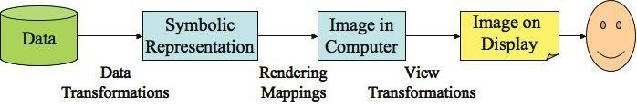
4. The Visualization Process
The visualization process at a high level view.

Slide 41
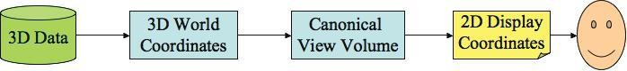
4.1. The Computer Graphics Pipeline
Stages:
Modeling. A 3-D model is generated using a world coordinate system.
Viewing. A virtual camera is defined at a location in world coordinates, along with a direction and orientation.
Clipping. By specifying the bounds of the desired image, objects out of view can be removed, and those that are partially visible can be clipped. (Clipping can actually be performed at many different stages of the pipeline.)
Hidden surface removal. Polygons facing away from the camera, or those obscured by others, are removed or clipped. (This process may be integrated into the projection process.)
Projection. 3-D polygons are projected onto the 2-D plane of projection, usually using a perspective transformation.
Rendering. The actual color of the pixels associated with a visible polygon depends on a number of factors. (This process may also be applied at different stages of the pipeline; it is usually performed in conjunction with projection.)

Slide 42
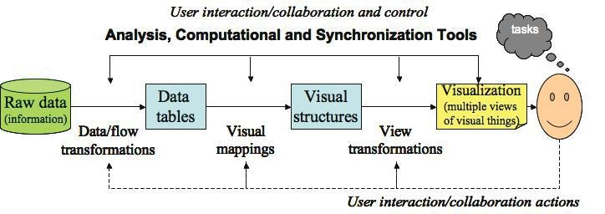
4.2. The Visualization Pipeline
Stages:
Data selection. Similar to clipping, data selection involves identifying the subset of the data that will be potentially visualized.
Data to visual mappings. The heart of the visualization pipeline is performing the mapping of data
values to graphical entities or their attributes.
Scene parameter setting (view transformations). The user must specify several attributes of the visualization independent of the data. These include color map selection (certain colors have clearly defined meaning), sound map selection, and lighting specifications (for 3D visualizations).
Rendering or generation of the visualization. The specific projection or rendering of the visualization objects varies according to the mapping being used; techniques such as shading or texture mapping might be involved, although many visualization techniques only require drawing lines and uniformly shaded polygons.
55

Slide 43
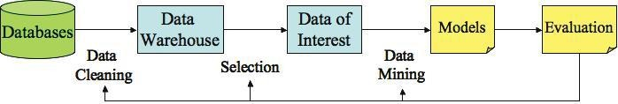
4.3. The Knowledge Discovery Pipeline
Stages:
Data. In the KD pipeline there is more focus on data, as the graphics and visualization processes often assume that the data is already structured to facilitate its display.
Data integration, cleaning, warehousing and selection. These involve identifying the various data sets that will be potentially analyzed. Can involve filtering, sampling, subsetting, aggregating, and other techniques that help curate and manage the data for the data mining step.
Data mining. The heart of the KD pipeline is algorithmically analyzing the data to produce a model.
Pattern evaluation. The resulting model or models must be evaluated to determine their robustness, stability, precision, and accuracy.
Rendering or visualization. The specific results must be presented to the user.

